Slide 1
User Requirements Notation (URN)
SEG3101 (Fall 2010)
Based on Powerpoint slides by Gunter Mussbacher, Gregor v. Bochmann

Slide 2
Table of Contents
Introduction to the User Requirements Notation (URN)
User Requirements Notation
jUCMNav Tool
Goals and Rationale
Goal-oriented Requirement Notation (GRL)
GRL Basics
Evaluations
Examples
Tools
Metamodel
All models are false but some models are useful.¹
[1] George Edward Pelham Box (1919-)

Slide 3
Modeling Puzzle – Common View
DATA
Informal Requirements, Textual Use Cases
Can we do
better to
bridge this gap?
Structural
Diagrams:
SDL, eODL, or UML class, object, component, & deployment diagrams
MSC, UML Use Case & Activity Diagrams
Behavioral Diagrams: MSC/SDL, or UML sequence, collaboration, & statechart diagrams
Testing and Performance Languages: TTCN, LQN, ...

Slide 4
Introduction to the User Requirements Notation (URN)

Slide 5
URN Overview (1)
URN is a semi-formal, lightweight graphical language for modeling and analyzing requirements in the form of goals and scenarios and the links between them
Combines two existing notations
Goal-oriented Requirement Language (GRL) (based on i* & NFR Framework)
Use Case Maps (UCMs)
Support for the elicitation, analysis, specification, and validation of requirements
Allows systems, software, and requirements engineers to discover and specify requirements for a proposed system or an evolving system, and analyse such requirements for correctness and completeness

Slide 6
URN Overview (2)
URN models can be used to specify and analyze various types of reactive systems, business processes, and telecommunications standards
jUCMNav
URN editor & analysis tool
Eclipse plug-in
Open source project

Slide 7
URN Overview (3)
vision
GRL
Model business goals, stakeholders’ priorities, alternative solutions, rationale, and decisions
called strategies, compared with GRL evaluation mechanism
traceability with URN links
extensible with metadata
with UCM traversal mechanism based on UCM scenario definitions
UCM
Model & test use cases; investigate high level architecture; transform to more detailed models
more detailed models
A GRL / UCM model visually communicates business objectives and constraints / high-level functional requirements to all stakeholders

Slide 8
Combination of Goals and Scenarios
URN combines two complementary parts:
The Goal-oriented Requirement Language (GRL)
For modelling goals and other intentional concepts (mainly for non-functional requirements, quality attributes, and reasoning about alternatives and tradeoffs)
The Use Case Map (UCM) notation
For modelling scenario concepts (mainly for operational requirements, functional requirements, and performance and architectural reasoning)
URN offers concepts for the specification of stakeholders, goals, non-functional requirements, rationales, behaviour, scenarios, scenario participants (actors), and high-level architectural structure

Slide 9
URN – Main Objectives
Focus on early stages of development with goals and scenarios
From user requirements to functional and non-functional system requirements
No messages, components, or component states required
Reusability
of argumentations (goal patterns and analysis)
of scenarios (patterns and architectural alternatives)
Early performance analysis
Traceability and transformations to other languages
Particularly MSC, SDL, TTCN, and UML
Also to LQN, LOTOS, and others

Slide 10
ITU-T Z.151: URN – Language Definition
URN is the first and currently only standard which explicitly addresses goals (non-functional requirements with GRL) in addition to scenarios (functional requirements with UCMs) in a graphical way in one unified language
International Telecommunication Union (ITU-T Z.150 series)
ITU-T Z.150 (02/03): User Requirements Notation (URN) - Language requirements and framework
ITU-T Z.151 (11/08): User requirements notation (URN) - Language definition
Part of the ITU family of languages: SDL, MSC, TTCN-3…
Definition of URN in Recommendation Z.151 (approved November 2008)
Metamodel, abstract/concrete syntaxes, semantics…
ITU-T Z.150: http://www.itu.int/rec/T-REC-Z.150/en ITU-T Z.151: http://www.itu.int/rec/T-REC-Z.151/en

Slide 11
About ITU-T
International Telecommunication Union
United Nations organization
191 countries + hundreds of member companies
Free access to the definition of many standard languages
http://www.itu.int/ITU-T/studygroups/com17/index.html
Question 13 (Formal languages and telecommunication software) of Study Group 17 (Security)
Z.15x User Requirements Notation (URN)
Also SDL, MSC, and profiles
Other international bodies standardize languages
ANSI (C, C++), W3C (HTML, XML), IEEE (VHDL), ISO (LOTOS), OMG (UML), OASIS (XACML), etc.

Slide 12
ITU-T Languages
SDL: Specification and Description Language
For defining and executing complete reactive systems
MSC: Message Sequence Charts
For defining message-oriented scenarios
ASN.1: Abstract Syntax Notation One
For defining data types/packets
TTCN-3: Testing and Test Control Notation
For defining test cases and test environments
URN: User Requirements Notation
Goal-oriented Requirements Language (GRL)
Use Case Map notation (UCM)
For defining abstract goals, scenarios, and requirements
UML 2.0 profiles for some of these languages on their way…

Slide 13
UML Puzzle
GRL captures stakeholders’ business goals, alternatives, decisions, and rationales.
Use Cases and
UML 2.0 Use Case Diagrams
Goal-oriented
Requirement
Language (GRL)
Alternatives in GRL are linked with more detailed models described as UCMs.
UML 2.0 Activity
Diagrams
UCMs represent visually use cases in terms of causal responsibilities.
UML 2.0
Structural
Diagrams
Use Case Maps
(UCMs)
UCMs provide a framework for making high level and detailed design decisions.
UML 2.0
Behavioral
Diagrams
Testing
Language
?
UCMs visually associate behavior with structure at the system level.
UCMs enable functional testing and allow the generation of test purposes.

Slide 14
ITU Puzzle
GRL captures stakeholders’ business goals, alternatives, decisions, and rationales.
Informal Require- ments, Textual Use Cases (M.3020)
Goal-oriented
Requirement
Language (GRL)
Alternatives in GRL are linked with more detailed models described as UCMs.
UCMs represent visually use cases in terms of causal responsibilities.
Structural
Diagrams:
SDL (Z.100)
Use Case Maps
(UCMs)
UCMs provide a framework for making high level and detailed design decisions.
Behavioral Dia-grams: SDL, MSC (Z.120)
Testing
Language:
TTCN (Z.140)
UCMs visually associate behavior with structure at the system level.
Data ASN.1 (X.680) where
appropriate
UCMs enable functional testing and allow the generation of test purposes.

Slide 15
Transformations
Transformations connect URN models to other models
Some transformations discussed in publications or implemented in jUCMNav’s predecessor UCMNav have not yet been implemented in jUCMNav
Test Cases (Fitnesse, TTCN)
UML activity/sequence/state/use case diagrams
SDL
Requirements Management (Telelogic DOORS)
Textual Use Cases (UCEd *)
User Requirements Notation (jUCMNav)
Core Scenario Model (CSM)
(for performance modeling)
Message Sequence Charts (MSC Viewer)
* Stéphane Somé’s UCEd: https://sourceforge.net/projects/uced/

Slide 16
Summary
The User Requirements Notation (URN) is an ITU-T standard
Modeling with the Goal-oriented Requirement Language
Focuses on answering “why” questions
Intentions, functional / non-functional requirements, rationales
Modeling with Use Case Maps
Focuses on answering “what” questions
Scenarios, services, architectures
While modelling with URN as a whole, goals are operationalized into tasks, and tasks are elaborated in scenarios (mapped to UCM path elements)
Moving towards answering “how” questions
Can guide the selection of an architecture or scenarios
Enables the elicitation/specification of systems, standards, & products, analysis from various angles, & transformations
Notes:
GRL supports the reasoning about scenarios by establishing correspondences between intentional GRL elements and non-intentional elements in scenario models of UCMs (hence describing the “how”). Modeling both goals and scenarios is complementary and may aid in identifying further goals and additional scenarios (and scenario steps) important to stakeholders, thus contributing to the completeness and accuracy of requirements.
In a development process, one would likely start with high-level goals that would be refined in terms of sub-goals and preliminary scenarios. As scenarios are refined, they can too impact the goal model. This would suggest an incremental and iterative process.

Slide 17

URN Tool: jUCMNav – Juice Up Your Modeling!
GRL
Strategies
Evaluation
UCMs
Scenario Definition
Scenario Execution
Test Suite
MSC Generation
Export to DOORS
Export to CSM
Pronounced: juicy – em – nav
http://jucmnav.softwareengineering.ca

Slide 18
URN Tool: jUCMNav – Overview (1)
Free (EPL), open-source plug-in for Eclipse
Based on Eclipse Modeling Framework (EMF) and the Graphical Editing Framework (GEF)
Supports most of GRL and UCM notation elements
Extensible architecture for customized GRL and UCM analysis techniques
4 GRL evaluation algorithms, with color highlight
1 UCM path traversal mechanism, with export to flat UCMs and MSCs
Integrated MSC viewer

Slide 19
URN Tool: jUCMNav – Overview (2)
Other features
Export performance models to CSM
Integration with DOORS for requirements management
Extensions for Business Process Modeling, Monitoring, and Adaptation
Extensions for aspect-oriented modeling with AoURN
Verification of user-defined (OCL) rules
Report generation (PDF, HTML)
Export of diagrams to various bitmap formats

Slide 20
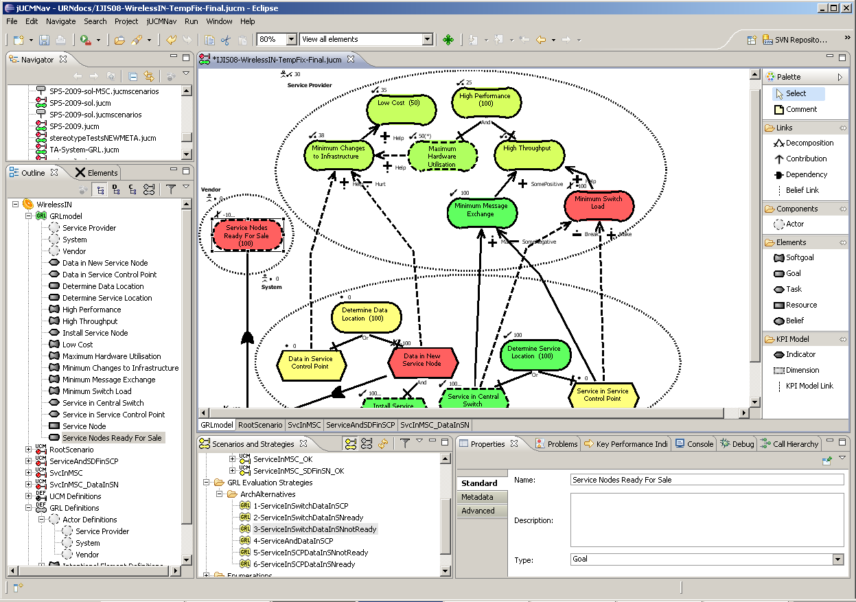
GRL Editor with Strategy Evaluation
Toolbar
Editor
Navigator view
Outline view
Palette
Properties view
Scenarios and Strategies view

Slide 21
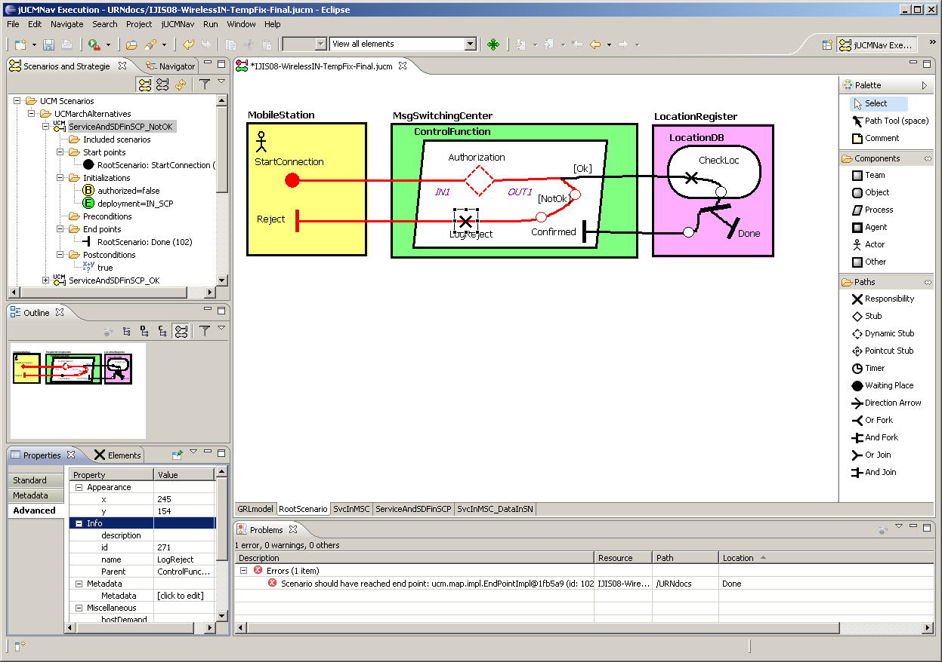
UCM Editor with Scenario Traversal
Perspective
Graphical Outline
Problems view

Slide 22
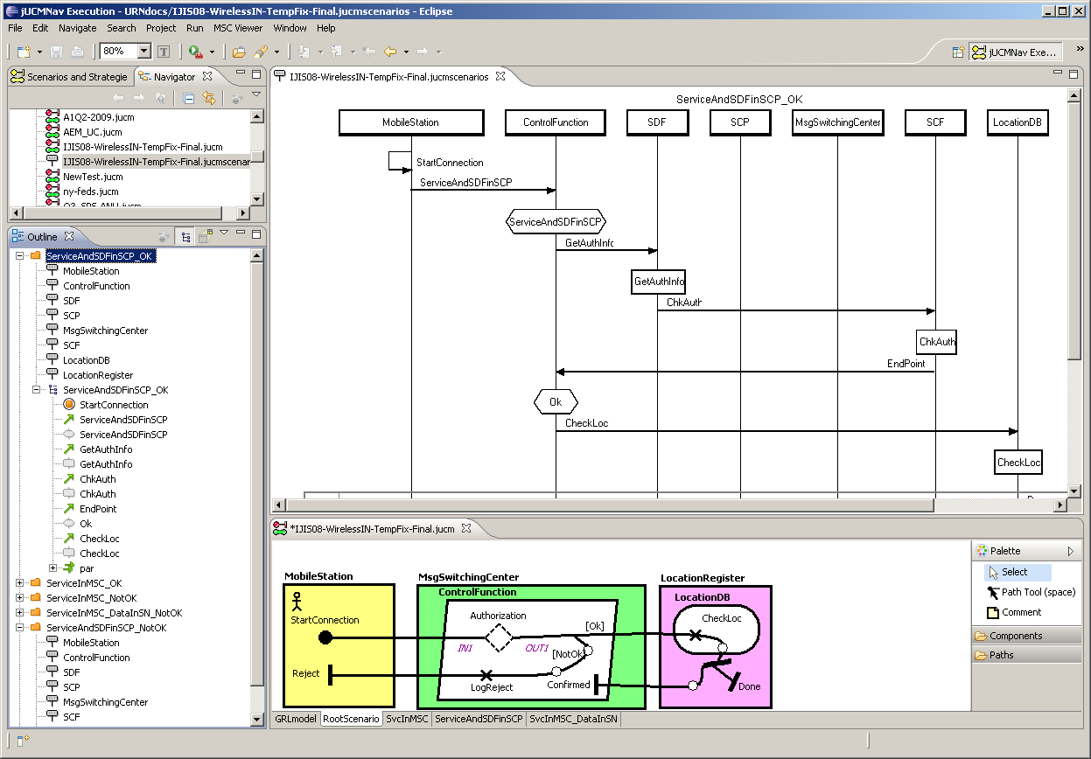
Integrated MSC Viewer for Exported UCM Scenarios
MSC viewer
Outline view

